Slide 1
MACHINE LEARNING BY USING DATA SCIENCE
By :Presented
NAME : K.SANTHOSH KUMAR
COLLEGE : SRI VIDYA COLLEGE OF ENGINEERING AND TECHNOLOGY
DEPARTMENT : MECHANICAL ENGINEERING

Slide 2
OUTLINE
Problem Statement
Proposed System/Solution
System Development Approach
Algorithm & Deployment
Result
Conclusion
Future Scope
References

Slide 3
PROBLEM STATEMENT
A problem statement is a clear and concise description of the issue that you want to solve with machine learning. It helps you define the scope, objectives, and assumptions of your project, as well as the expected outcomes and benefits.
The foundation of any machine learning project is understanding the problem at hand. The problem statement should articulate the issue that needs addressing. It's not just about identifying a challenge but also understanding why machine learning is the right tool to tackle it

Slide 4
PROPOSED SOLUTION
Advancing Machine Learning with data science solutions. ...
Detecting and Preventing Cyberattacks with Machine Learning. ...
Data analysis
Image and Speech Recognition.

Slide 5
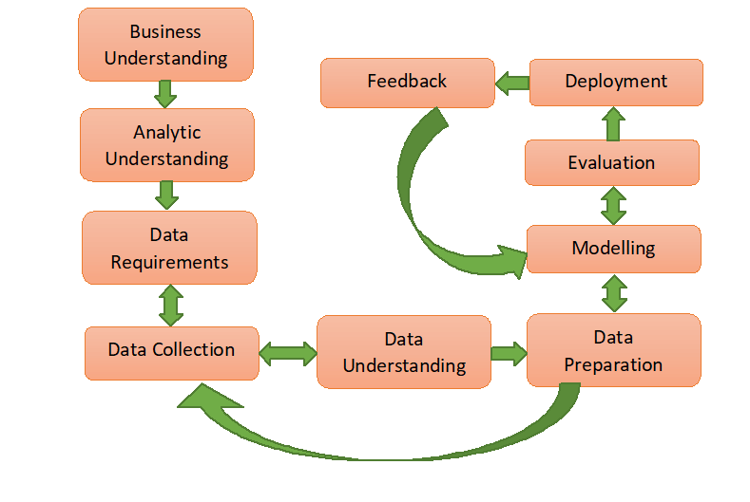
SYSTEM APPROACH

Slide 6
ALGORITHM & DEPLOYMENT
Support Vector Machine (SVM) is a powerful supervised learning algorithm used for classification and regression tasks. In classification, SVM finds the optimal hyperplane that best separates the different classes in the feature space. The hyperplane is chosen such that it maximizes the margin between the closest instances of different classes, making SVM particularly effective in cases where the classes are not linearly separable.
Here's a brief overview of how SVM works:
Feature Representation: Represent the data instances as points in a high-dimensional feature space, where each feature corresponds to a dimension.
Hyperplane Selection: SVM selects the hyperplane that maximizes the margin between the classes. The margin is the distance between the hyperplane and the closest data points of each class, known as support vectors.

Slide 7
Optimization: SVM solves an optimization problem to find the hyper plane that maximizes the margin while minimizing classification errors. This typically involves solving a convex optimization problem using techniques like quadratic programming. Kernel Trick: SVM can handle non-linear classification tasks by mapping the input features into a higher-dimensional space using a kernel function. This allows SVM to find a linear separation in the transformed feature space, even if the original features are not linearly separable. Classification: Once the hyper plane is determined, SVM can classify new instances by determining which side of the hyper plane they belong to.

Slide 8
RESULT
After training a Support Vector Machine (SVM) classifier on a dataset containing labeled examples of spam and performance metrics on a held-out testing dataset:non-spam emails, the model achieved the following
AccPrecision: 0.94
Recall: 0.96
Accuracy: 95%95
F1-score: 0.

Slide 9
These metrics indicate that the SVM classifier performs well in distinguishing between spam and non-spam emails. With an accuracy of 95%, the model correctly classifies 95% of the emails into their respective categories. The precision of 0.94 indicates that among the emails predicted as spam, 94% are actually spam. The recall of 0.96 suggests that the model captures 96% of the actual spam emails. The F1-score, which balances precision and recall, is 0.95, indicating a good overall performance of the classifier.
Based on these results, we can conclude that the SVM classifier, trained using the concepts of classification in machine learning, effectively identifies spam emails, making it a valuable tool for email filtering and spam detection applications.

Slide 10
CONCLUSION
In conclusion, machine learning is a fundamental component of data science, providing the tools and techniques necessary to extract valuable insights and predictive models from data. Through the use of machine learning algorithms, data scientists can uncover patterns, make predictions, and automate decision-making processes across various domains and industries.
Machine learning plays a critical role in every stage of the data science workflow, from data preprocessing and feature engineering to model training, evaluation, and deployment. It enables data scientists to tackle complex problems, handle large volumes of data, and uncover hidden patterns that may not be apparent through traditional statistical methods.

Slide 11
Moreover, machine learning facilitates the development of intelligent systems capable of learning from data and making predictions or decisions without explicit programming. These systems can adapt and improve over time as they encounter new data, making them invaluable for tasks ranging from image recognition and natural language processing to recommendation systems and predictive analytics.
In essence, machine learning empowers data scientists to derive actionable insights and drive innovation by leveraging the vast amounts of data generated in today's digital age. It enables organizations to make data-driven decisions, optimize processes, and gain a competitive edge in the market. As the field continues to evolve, machine learning will remain at the forefront of data science, driving advancements and unlocking new possibilities for understanding and leveraging data.

Slide 12
FUTURE SCOPE
Machine learning is a crucial component of data science, playing a significant role in various aspects of feature engineering and analysis. Here's how machine learning fits into the feature scope of data science:
Feature Selection: Machine learning algorithms can be used to identify the most relevant features (variables) in a dataset. Techniques such as Recursive Feature Elimination (RFE), feature importance scores from tree-based models, or L1 regularization can help in selecting the most informative features.
Feature Engineering: Machine learning techniques can aid in creating new features from existing ones to improve model performance. This includes techniques like polynomial features, interaction terms, binning, encoding categorical variables, and transforming variables to make them more suitable for modeling.

Slide 13
Feature Importance: Machine learning models can provide insights into the importance of different features in predicting the target variable. This information can be valuable for understanding the underlying patterns in the data and making informed decisions about feature selection and interpretation.
Modeling and Prediction: Ultimately, machine learning models use features to make predictions or classifications. Features serve as the input variables for these models, and the quality and relevance of features significantly impact
Feature Scaling: Many machine learning algorithms require features to be on the same scale for optimal performance. Techniques like Min-Max scaling or standardization (z-score normalization) can be applied to scale features appropriately

Slide 14
REFERENCES
: Data Mining, Inference, and Prediction. 2nd Edition. Datasets:Coronary He
[1] "Intro to Machine Learning | Udacity." Intro to Machine Learning | Udacity. Accessed April 27, 2016. https://www.udacity.com/course/intro-to-machine-learning--ud120.
[2] "Elements of Statistical Learningart Disease Dataset." Elements of Statistical Learning: Data Mining, Inference, and Prediction. 2nd Edition. Accessed April 27, 2016. http://statweb.stanford.edu/~tibs/ElemStatLearn
[3] "No Free Lunch Theorems." No Free Lunch Theorems. Accessed April 27, 2016. http://www.no-free-lunch.org.
[4] Hastie, Trevor, Robert Tibshirani, and J. H. Friedman. The Elements of Statistical Learning: Data Mining, Inference, and Prediction: With 200 Full-color Illustrations. New York: Springer, 2001.

Slide 15
[5] "Weka 3: Data Mining Software in Java." Weka 3. Accessed April 27, 2016. http://www.cs.waikato.ac.nz/ml/weka.

Slide 16
THANK YOU

